Slide 1
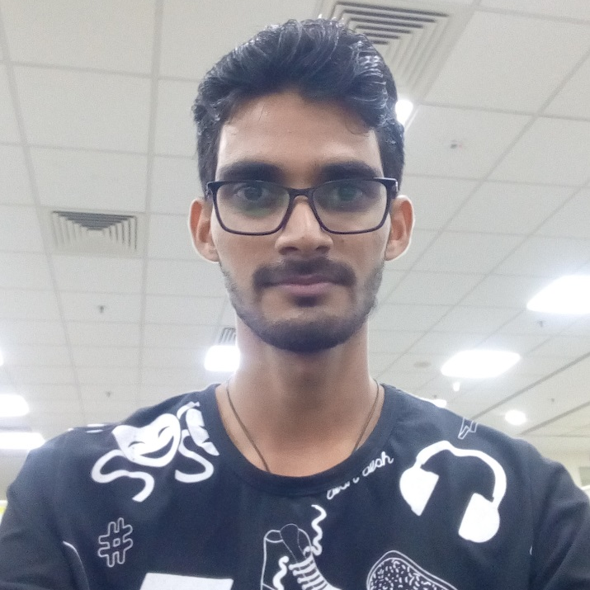
Hello Guys
Dhiraj Mhatre,
Working in Kotak since 2015
Key Focus Area :
KS-API Documentation
KS-API Development
L2 Technical Support
Admin Website
Dhiraj Mhatre
Software Engineer

Slide 2
Key Responsibilities
Key responsibility to develop and maintain APIs and Deployment.
Miscellaneous Application
API Development
Deployment & Maintenance
API development for applications like KEAT, KST, KS-Dealer, Fastlane etc.
Documentation for KS-API
Integration of existing APIs in Industry Standard JSon format
Develop Web Page to check Shared Memory details like Client details and Scrip details
This helps support team to resolve Shared Memory related issues quickly.
Admin Site
KS-API
Trading site

Slide 3
Change Makes the Difference
Key areas needs to be looked at in near Future
Integration of APIs
Integration of existing APIs in Industry Standard JSon format.
Service related APIs (One View)
Connector
Minimize repetitive queries
By providing proper documentation to L1 Support Team
DR Implementation
Implementation of DR in APIs.

Slide 4
Get in Touch
dhiraj.mhatre@kotak.com
9604890225
Goregaon ,
Infinity IT Park
Thank you.

